Slide 1




“It’s
easy and
beneficial.”
“It’s
important
and
required.”
Brief Tutorial on Completing
the OSHA Recordkeeping Forms
Notes:
Welcome to the Agency’s tutorial on completing OSHA recordkeeping forms.

Slide 2


Brief Tutorial on Completing the OSHA Recordkeeping Forms
A review of the recordkeeping requirements and forms at a high level:
Requirement to complete the forms and evaluate specific exceptions
The forms in OSHA’s recordkeeping package
Recordability criteria for injuries and illnesses
Recording injuries/illnesses on the forms
1
2
Notes:
This brief presentation reviews OSHA recordkeeping requirements at a high level, with an emphasis on how to fill out the forms provided in OSHA’s Recordkeeping Forms package. The tutorial covers what types of operations come under the recordkeeping rule and thus are required to complete the forms, what types of injury and illness incidents must be recorded, and what information is to be included in each of the three OSHA forms respectively.

Slide 3

Who has to complete the OSHA injury and illness recordkeeping forms?
Many but not all employers. Exceptions are based on:
Small employer exemption – 10 or fewer employees at all times during the year
Low-hazard industry exemption – see list of Partially Exempt Industries (PDF)
Fatality and other serious event reporting as well as injury and illness surveys involve other considerations.
“It’s
easy and
beneficial.”
2
3
Notes:
Many but not all employers must complete the OSHA injury and illness recordkeeping forms on an ongoing basis.
Employers with 10 or fewer employees throughout the previous calendar year do not need to complete these forms. Said another way, if there are more than 10 employees at any time during that calendar year, the employer may come under the requirement. When counting employees, you must include full-time, part-time, temporary, and seasonal workers. This exemption is based on the employment of the entire company rather than the establishment. For example, if a company has two establishments, one with 5 employees and one with 7 employees, the company must fill out the forms for each establishment because the company employment is greater than 10.
In addition to the small employer exemption, there is an exemption for establishments classified in certain industries. For example, the forms do not need to be completed for restaurants, banks, and medical offices. A complete list of exempt industries can be found on this slide by using the Partially Exempt Industries link.
Establishments normally exempt from keeping the OSHA forms must complete the forms if they are informed in writing to do so by the Bureau of Labor Statistics or OSHA. Also, exempt establishments must report to OSHA within 8 hours any work-related fatality. Work-related amputations, in-patient hospitalizations, and the loss of an eye must be reported to OSHA within 24 hours of learning of the incident. These events can be reported by phone to the local OSHA Area Office or by using the OSHA 800 number (1-800-321-6742) or by using the reporting application on OSHA’s public website.

Slide 4

What forms must be completed?
OSHA Form 300 – Log of Work-Related Injuries and Illnesses
OSHA Form 301 – Injury and Illness Incident Report
OSHA Form 300A – Summary of Work-Related Injuries and Illnesses
3
4
Notes:
There are three forms you--the employer--must complete. OSHA forms 300 and 301 are maintained on an ongoing basis. Recordable injuries and illnesses must be entered on these forms as they occur throughout the year. The OSHA Form 300A is completed after the end of the year, summarizing the number of recordable cases that occurred. Employers may use equivalent forms in place of these forms as long as the equivalent forms contain all of the same data elements and are as easy to read as the OSHA forms.

Slide 5

What cases need to be recorded on the forms?
Injuries and illnesses
Work related
Meet certain severity criteria
“It’s
important
and
required.”
4
5
Notes:
Any work-related injury or illness that meets certain severity criteria must be entered on the forms within 7 calendar days of learning about its occurrence. We’ll talk about each of these bullet items on the next few slides.

Slide 6

What is considered an injury or illness?
An abnormal condition or disorder
Not an exposure, unless it results in signs or symptoms
5
6
Notes:
OSHA defines an injury or illness as an abnormal condition or disorder. Injuries and illnesses include cases such as cuts, fractures, sprains, skin diseases, or respiratory conditions. For OSHA recordkeeping purposes, an injury or illness can also consist of only subjective symptoms such as aches or pain.
Exposures that do not result in signs or symptoms are not considered injuries or illnesses and should therefore not be recorded on the OSHA forms. For example, if an employee is exposed to chlorine and does not exhibit any signs or symptoms due to the exposure, the case would not be recorded on the Log, even if it involved prophylactic—that is, preventative--medical treatment.

Slide 7

What cases are work related?
Cases caused by events or exposures in the work environment
Cases contributed to by events or exposures in the work environment
Cases significantly aggravated by events or exposures in the work environment
(For a list of activities that are not work related, see section 1904.5(b)(2) [PDF].)
“It’s
easy and
beneficial.”
6
7
Notes:
Cases that are caused, contributed to, or significantly aggravated by events or exposures in the work environment are considered work related for OSHA recordkeeping purposes. Work-relatedness is presumed for injuries and illnesses occurring in the workplace or in locations where the employee is located as a condition of employment. It’s important to remember that if work makes any contribution to the injury or illness, it is considered work-related for OSHA recordkeeping purposes.
There are certain activities that occur in the work environment that OSHA does not consider work related. For example, injuries resulting directly from eating, drinking, or preparing ones own food at the workplace are not considered work related. For a complete list of these activities, refer to section 1904.5(b)(2) using the link found on this slide.

Slide 8

What are the severity criteria for recording a work-related injury or illness?
Death
Loss of consciousness
Days away from work
Restricted work activity or job transfer
Medical treatment beyond first aid
7
8
Notes:
Work-related injuries and illnesses that result in death, loss of consciousness, days away from work, restricted work activity, transfer to another job, or medical treatment beyond first aid must be recorded on the OSHA forms. We’ll talk about these criteria on the next few slides.

Slide 9
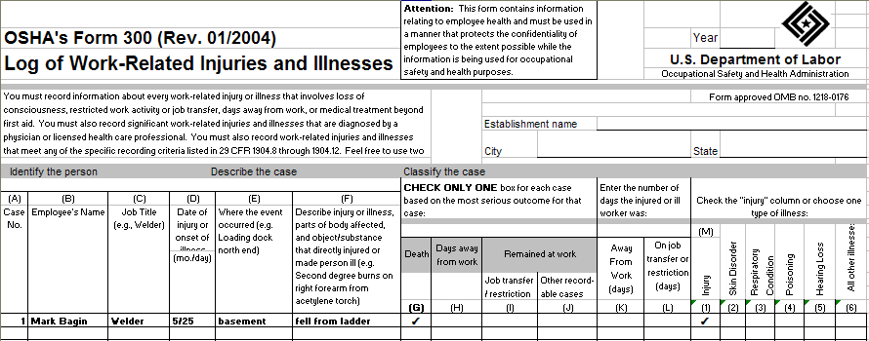

OSHA Form 300: Recording a Fatality
“It’s
important
and
required.”
8
9
Notes:
For cases involving a fatality, enter a checkmark in column G on the OSHA Form 300. Note in column M whether the case involved an injury or an illness.
Also remember that you must report the fatality to OSHA within 8 hours of learning of its occurrence. The event can be reported by phone to the local OSHA Area Office or by using the OSHA 800 number (1-800-321-6742) or by using the reporting application on OSHA’s public website.

Slide 10
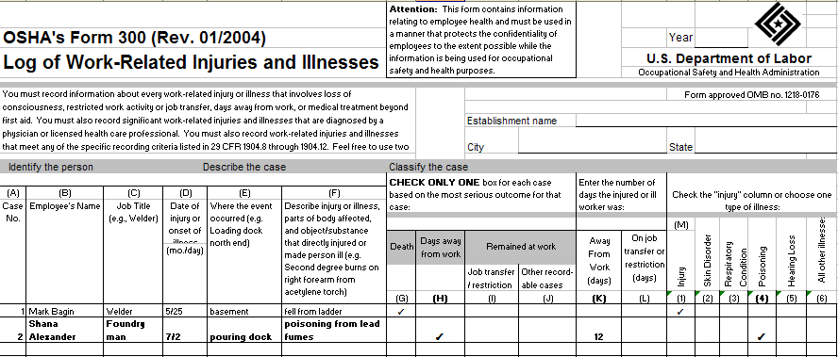
OSHA Form 300: Recording a Case with Days Away From Work
9
10
Notes:
For cases that involve one or more days away from work, you must place a checkmark in column H on the OSHA Form 300 and enter the number of calendar days the employee was away from work in column K. Then note in column M whether the case involves an injury or an illness.
When counting days, be sure to count the days the employee would not have been able to work regardless of whether he or she was scheduled to work. This would include weekends and holidays. Do not count the day of the injury. If the day count reaches 180 calendar days, you may stop counting subsequent days and enter 180 in column K.

Slide 11
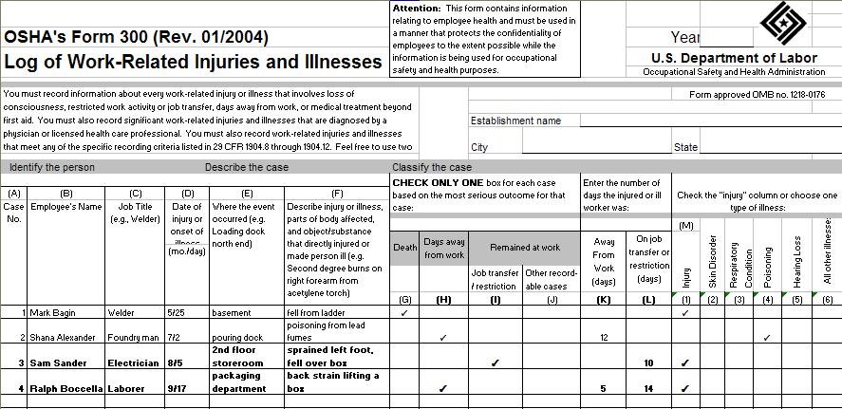
OSHA Form 300: Recording a Case with Restricted Work Activity or Job Transfer
“It’s
easy and
beneficial.”
10
11
Notes:
For cases that involve restricted work activity or job transfer, you must place a checkmark in column I on the OSHA Form 300 and enter the number of calendar days the employee was restricted in column L. You count the days in the same manner as counting days away from work. Then note in column M whether the case involves an injury or an illness.
An employee is considered restricted if he or she is unable to work a full shift or is unable to perform all of the work activities he or she would be expected to do at least once during a week.
If a case involves both days away from work AND days of restricted work activity, place a checkmark in column H, leave column I blank, and enter the correct day counts in both columns K and L. (For example, if an employee had 3 days away from work and 2 of restricted work activity, place a checkmark in column H and enter a 3 in column K and a 2 in column L.) Again, note in column M whether the case involves an injury or an illness.

Slide 12
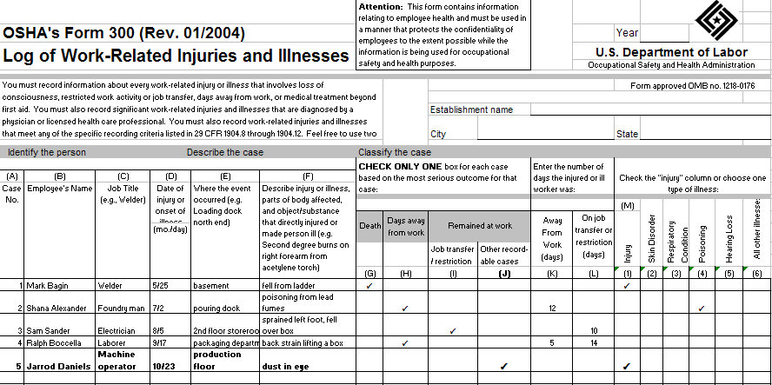
OSHA Form 300: Recording a Case with Medical Treatment beyond First Aid
(For a list of specific treatments considered to be first aid, see section 1904.7(b)(5) [PDF].)
11
12
Notes:
For cases that involve medical treatment beyond first aid, you must place a checkmark on the OSHA Form 300 in column J, which is for “other recordable cases.” Then note in column M whether the case involves an injury or an illness.
For OSHA recordkeeping purposes, medical treatment is any treatment for an injury or illness except diagnostic procedures, observation and counseling, and first aid. First aid consists of 14 specific treatments listed in section 1904.7(b)(5) of the regulatory text. It includes items such as non-prescription medication, wound coverings, and hot and cold treatment. You can access the complete list using the Regulatory Text link on this web page or by looking in the Overview section of the Recordkeeping Forms package (also linked from the Recordkeeping page).

Slide 13

Other Recording Criteria
Significant diagnosed injury or illness
Needlestick and sharps injuries – section 1904.8 (PDF)
Medical removal – section 1904.9 (PDF)
Hearing loss – section 1904.10 (PDF)
Tuberculosis – section 1904.11 (PDF)
“It’s
important
and
required.”
12
13
Notes:
Work-related cases of cancer, chronic irreversible disease, fractured or cracked bones or teeth, or a punctured ear drum must be entered on the OSHA forms. These are considered significant injuries and illnesses.
The recordkeeping rule also contains special criteria for recording occupational hearing loss, tuberculosis, injuries from needlesticks and sharps potentially contaminated with bloodborne pathogens, and cases involving medical removal required by other OSHA standards. For the specific requirements, refer to sections 1904.8 through 1904.11 using the links on this slide or by looking in the Overview section of the Recordkeeping Forms package (also linked from the Recordkeeping page).

Slide 14
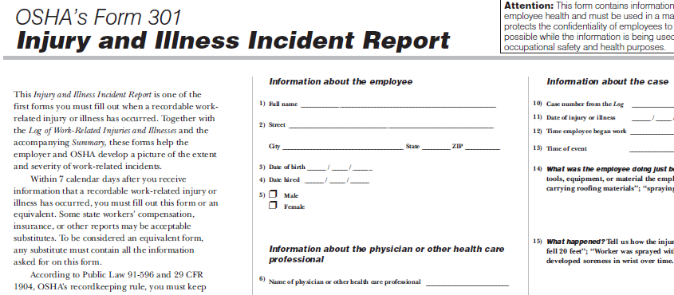
OSHA Form 301: Injury and Illness Incident Report
13
14
Notes:
You must fill out an Injury and Illness Incident Report for every recordable work-related injury or illness. Together with the Log of Work-Related Injuries and Illnesses and the accompanying Summary, these forms help the employer and OSHA develop a picture of the extent and severity of work-related incidents.
Within 7 calendar days after you receive information that a recordable work-related injury or illness has occurred, you must fill out this form or an equivalent. Some state workers' compensation, insurance, or other reports may be acceptable substitutes. To be considered an equivalent form, any substitute must contain all the information asked for on this form.

Slide 15
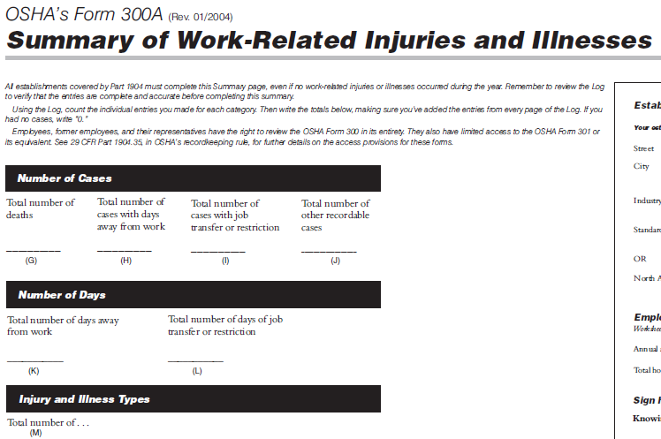
OSHA Form 300A: Summary of Work-Related Injuries and Illnesses
“It’s
easy and
beneficial.”
14
15
Notes:
All establishments covered by Part 1904 must complete the Summary of Work-Related Injuries and Illnesses, even if no injuries or illnesses occurred during the year. Remember to review the Log to verify that the entries are complete and accurate before completing this summary. Using the Form 300, count the individual entries you made for each category. Then, write the totals on the left side of the Form 300A, making sure you've added the entries from every page of the Log. If you had no cases, write in a zero.

Slide 16
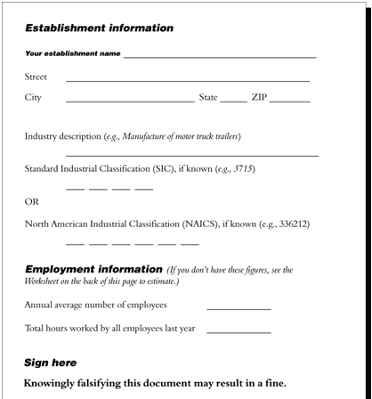
OSHA Form 300A: Summary of Work-Related Injuries and Illnesses (continued)
15
16
Notes:
On the right side of the Form 300A, fill in the establishment information.
Also in this section of the form, a company official must certify that the entries on the summary are true, accurate, and complete. The certifying official must be the owner of the company, an officer of the corporation, the highest ranking company official at the establishment, or that person’s supervisor.
You must post a copy of the annual summary in each establishment in a conspicuous place or places where notices to employees are customarily posted. You must post it no later than February 1 of the year following the year covered by the records and keep the posting in place for three months until April 30.

Slide 17

Keep the Forms on File
File and update for 5 years
Do not send copies to OSHA unless asked to do so
Allow access to the records
(For details on access provisions, see section
1904.35 [PDF] and 1904.40 [PDF].)
“It’s
important
and
required.”
16
17
Notes:
You must keep these forms on file for 5 years following the year to which they pertain. You must also update the Form 300 with any changes that may occur to the recorded cases during that period. Do not send completed copies of the forms to OSHA. You must make the forms available to employees, former employees, their representatives, and to OSHA officials upon request. (Note, however, that both the Log 300 and Form 301 incident reports will include information relating to employee health and thus can only be used in a manner that protects confidentiality to the extent possible while promoting occupational safety and health.) For details concerning the access provisions, refer to sections 1904.35 and 1904.40 using the link on this page.

Slide 18
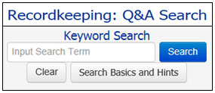
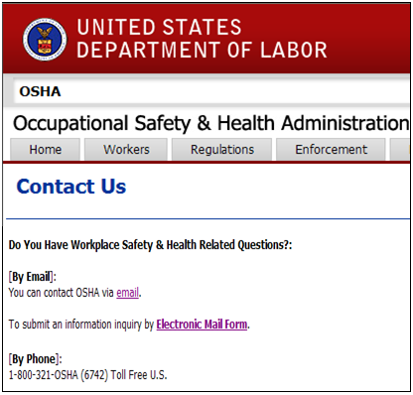
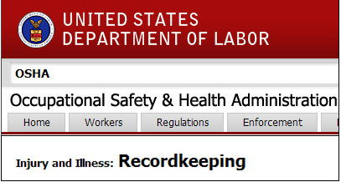
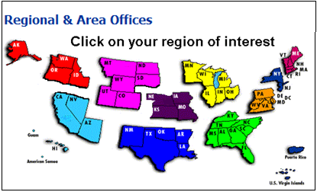

Resources
Recordkeeping web page (https://www.osha.gov/recordkeeping)
Q&A Search web page (https://www.osha.gov/recordkeeping/faq_search/index.html)
Local OSHA Offices https://www.osha.gov/html/RAmap.html)
E-correspondence/Contact us (https://www.osha.gov/html/Feed_Back.html)
17
18
Notes:
In conclusion, this presentation reviewed OSHA’s injury and illness recordkeeping requirements at a very high level. The Recordkeeping page, however, includes links to reference documents that address the specific requirements of the recordkeeping rule and answer many reoccurring questions, as well as a link to the recordkeeping forms package itself. To learn the details of what you need to do to be in compliance with the recordkeeping rule, you may want to take some time to familiarize yourself with the Regulatory Text and FAQs posted here. The Letters of Interpretation and the Recordkeeping Handbook are also useful reference documents linked from the Recordkeeping page.
If you have specific questions that you cannot find direct guidance for in these documents, you may want to try the Recordkeeping Q&A Search application. Also, feel free to call your local OSHA office or submit your question using OSHA’s e-correspondence web page. You can get a list of OSHA offices and can access OSHA’s Electronic Mail Form using the Contact Us link at the bottom of the Recordkeeping page.
Thanks for helping to make the nation’s workplaces safer.

